Slide 1
Houdini Fooling Deep Structured Prediction Models (Houdini)
Sayantan Sarkar University of Maryland
2017 未发表

Slide 2
Outline
Scenario
Observe Imagine
Problem
Multiple Angles
Solution
Theory Tool
Performance
Effectiveness Cost

Slide 3
1
Scenario & Problem
Scenario:
不可微的ML模型loss function
（1）human pose estimation 姿态估计
（2）speech recognition 语音识别：
白盒：DeepSpeech-2 黑盒：Google Voice
（3）semantic segmentation语义分割
Problem:
直接最优化的方法不考虑，怎样找到一个更好的替代loss
Reference:
D. Amodei, R. Anubhai, E. Battenberg, C. Case, J. Casper, B. Catanzaro, J. Chen, M. Chrzanowski, A. Coates, G. Diamos, et al. Deep speech 2: End-to-end speech recognition in english and mandarin. arXiv preprint arXiv:1512.02595, 2015.
A. Newell, K. Yang, and J. Deng. Stacked hourglass networks for human pose estimation. ECCV, 2016.
N. Papernot, P. McDaniel, I. Goodfellow, S. Jha, Z. Berkay Celik, and A. Swami. Practical black-box attacks against deep learning systems using adversarial examples. arXiv preprint arXiv:1602.02697, 2016.

Slide 4



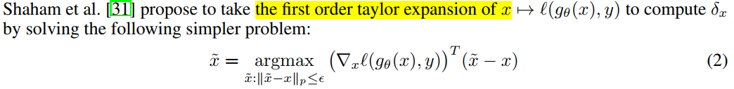
3
Solution
Prior work：
x的泰勒展开式的一阶

Slide 5
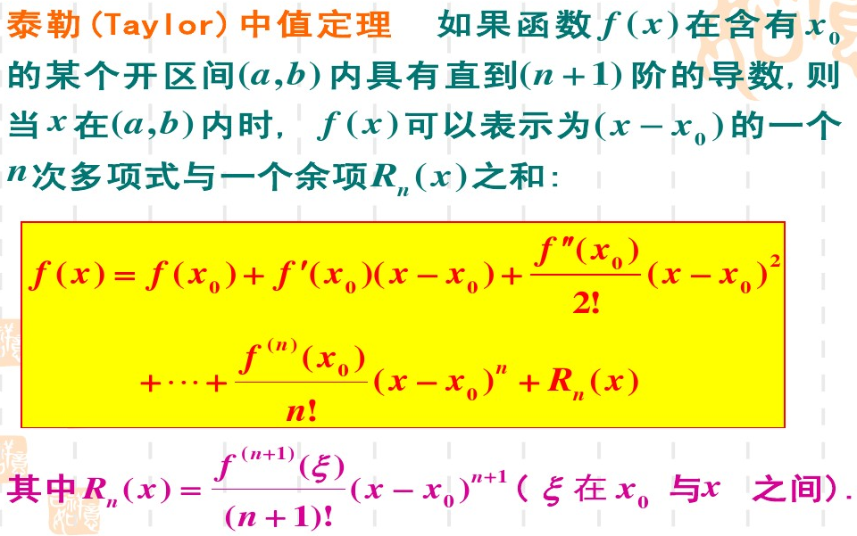
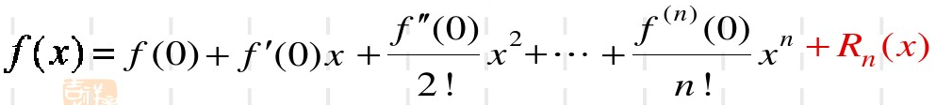
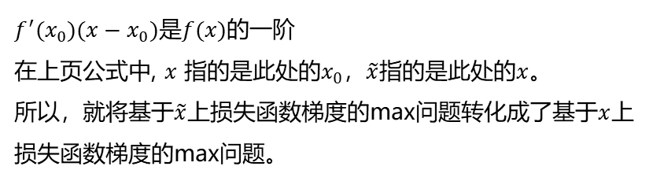
3
Solution
$f^{′}(x_{0})(x−x_{0})$是$f(x)$的一阶
在上页公式中, $x$ 指的是此处的$x_{0}$，$\tilde{x}$指的是此处的$x$。
所以，就将基于$\tilde{x}$上损失函数梯度的max问题转化成了基于$x$上损失函数梯度的max问题。
$n=0$时，泰勒公式=拉格朗日中值公式
$x_{0}=0$时，泰勒公式=麦克劳林公式

Slide 6


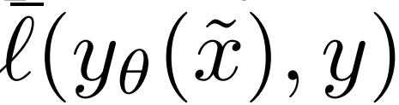


3
Solution
Prior work：
一种替代损失：probit loss
Houdini loss:
Structured hinge loss:
Log loss:
Houdini loss:
Surrogate loss:

Slide 7


3
Solution
Houdini loss:
use Houdini in place of the task loss.
梯度求解：第一层是采用泰勒一阶近似，之后用链式法则。
Houdini loss的input是network的output值。

Slide 8

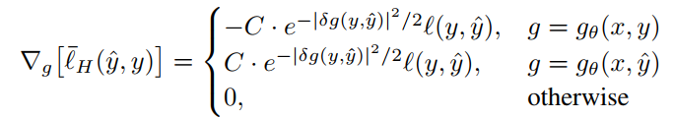
3
Solution
Houdini loss:

Slide 9
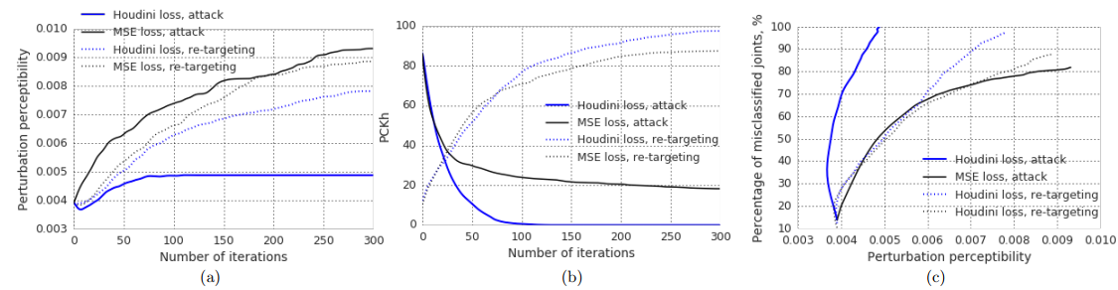
4
Performance on deep model for human pose estimation
pose estimation task：
（1）given a single RGB image of a person
（2）determine correct 2D positions of several pre-defined key points which typically correspond to skeletal joints（骨骼关节）.
评估指标：percentage of correctly detected keypoints (PCKh)

Slide 10



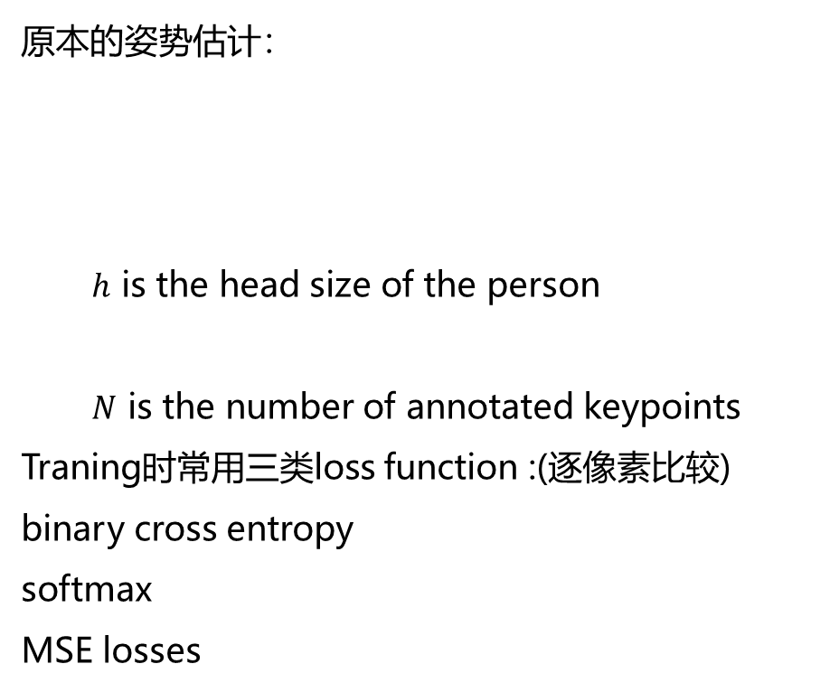
4
Performance on deep model for human pose estimation
原本的姿势估计：
$h$ is the head size of the person
$N$ is the number of annotated keypoints
Traning时常用三类loss function :(逐像素比较)
binary cross entropy
softmax
MSE losses
攻击：

Slide 11
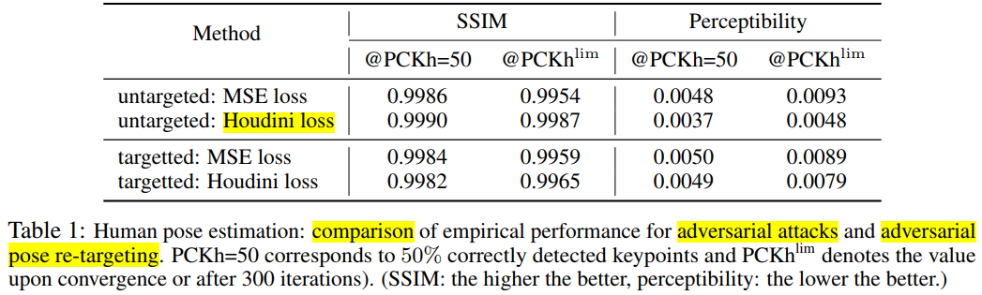
4
Performance on deep model for human pose estimation

Slide 12
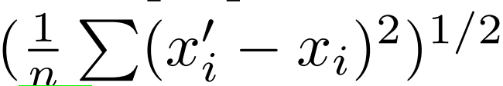
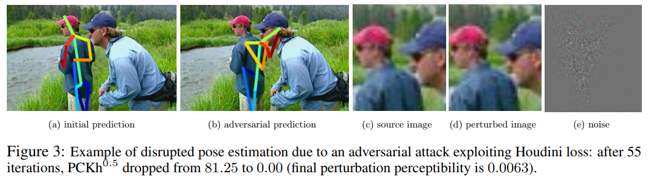
4
Performance on deep model for human pose estimation
evaluate the perceived degree of perturbation

Slide 13
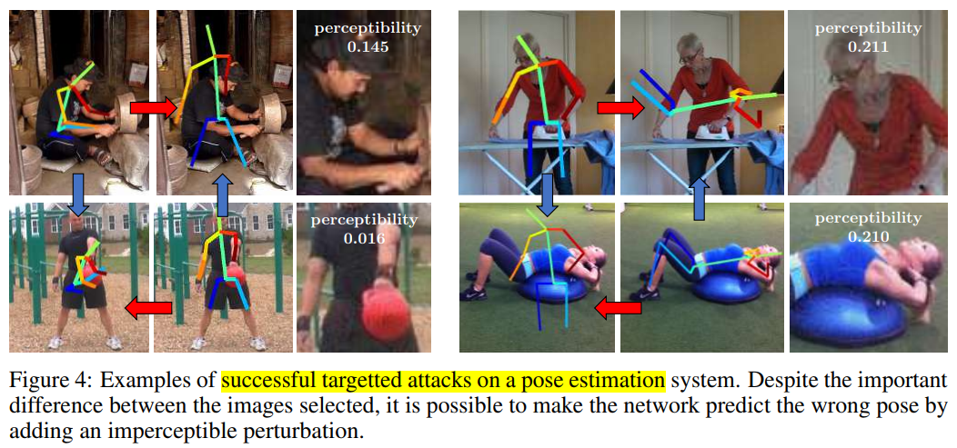
4
Performance on deep model for human pose estimation

Slide 14
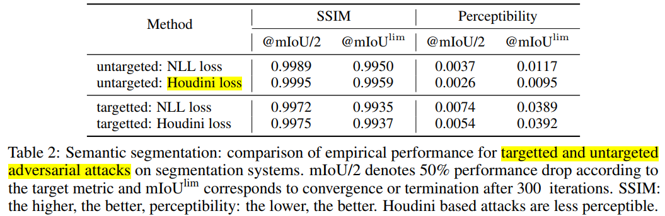
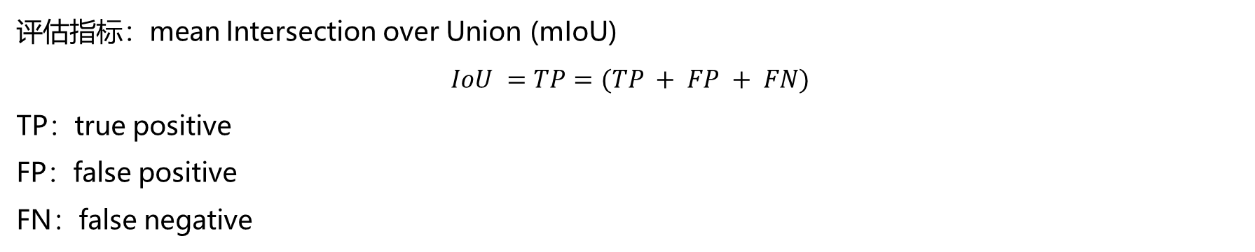
4
Performance on semantic segmentation system
评估指标：mean Intersection over Union (mIoU)
$$IoU =TP=(TP + FP + FN)$$
TP：true positive
FP：false positive
FN：false negative

Slide 15
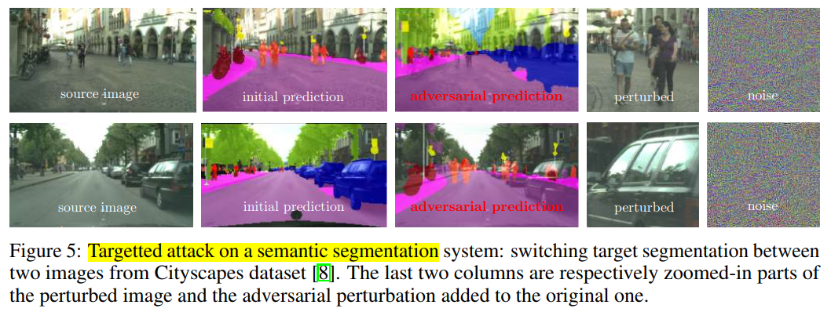
4
Performance on semantic segmentation system
the target segmentation is the ground truth segmentation of a different image

Slide 16
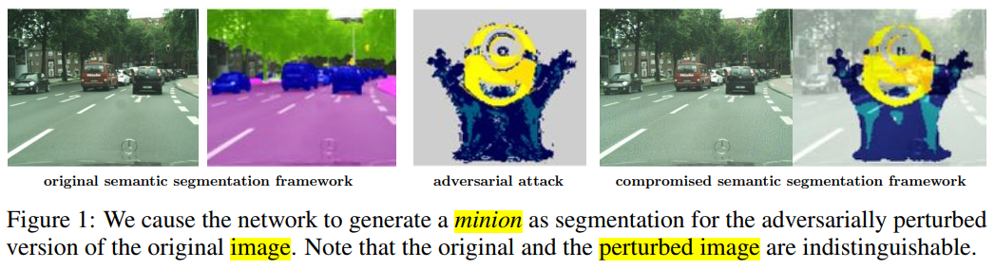
4
Performance on semantic segmentation system
the target segmentation is an arbitrary map（更难）

Slide 17
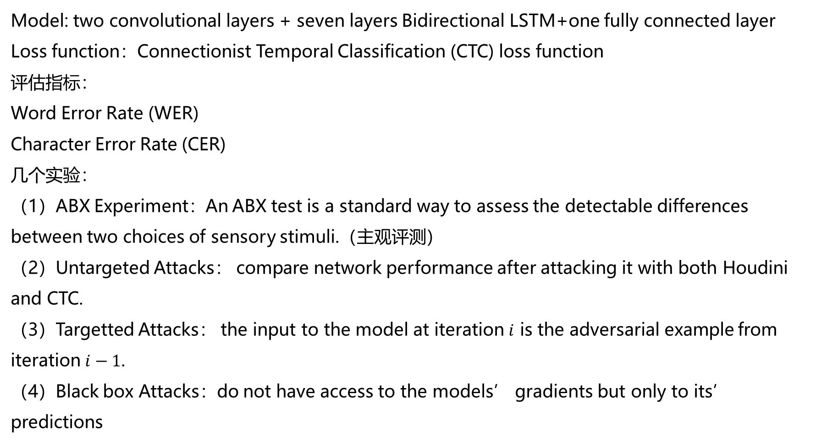
4
Performance on deep Automatic Speech Recognition (ASR) system
Model: two convolutional layers + seven layers Bidirectional LSTM+one fully connected layer
Loss function：Connectionist Temporal Classification (CTC) loss function
评估指标：
Word Error Rate (WER)
Character Error Rate (CER)
几个实验：
（1）ABX Experiment：An ABX test is a standard way to assess the detectable differences
between two choices of sensory stimuli.（主观评测）
（2）Untargeted Attacks： compare network performance after attacking it with both Houdini and CTC.
（3）Targetted Attacks： the input to the model at iteration $i$ is the adversarial example from iteration $i−1$.
（4）Black box Attacks：do not have access to the models’ gradients but only to its’ predictions

Slide 18
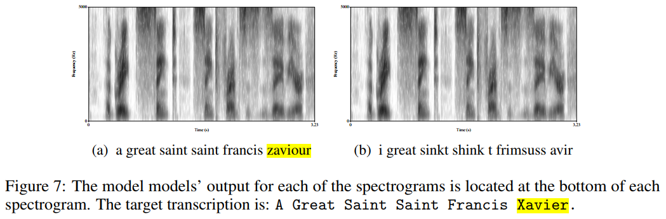
4
Performance on deep Automatic Speech Recognition (ASR) system
Untargeted attack: original and adversarial spectrograms for a single speech segment.

Slide 19
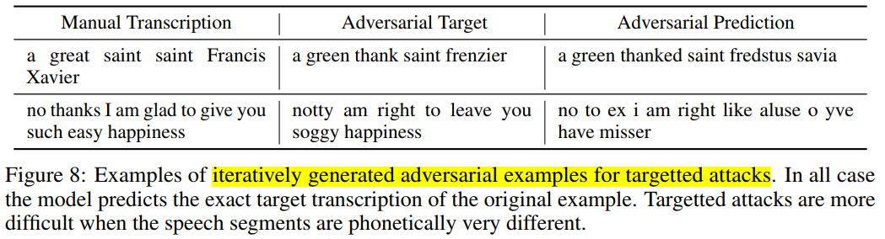
4
Performance on deep Automatic Speech Recognition (ASR) system

Slide 20
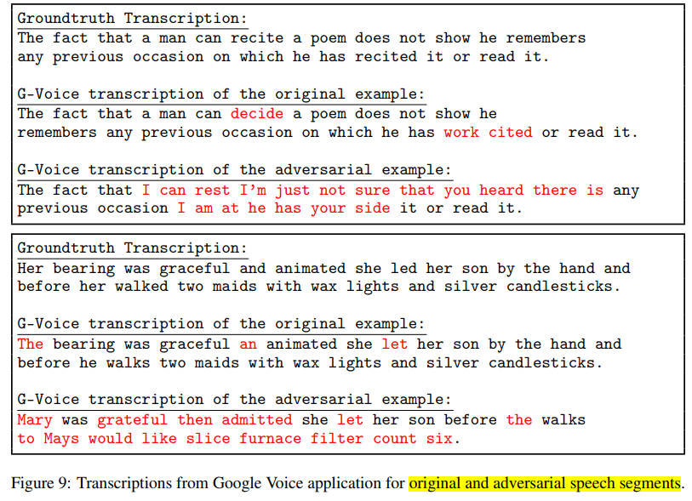
4
Performance on deep Automatic Speech Recognition (ASR) system
Black attack
Google Voice

Slide 21
4
Conclusion
Houdini损失函数的设计受到SVM、条件随机场中的loss启发，属于结构化预测。

